Slide 1
CPSC 375 Introduction to Data Science and Big Data Analytics
Dr. Anand Panangadan
apanangadan@fullerton.edu

Slide 2
What we will cover this week
k-nearest neighbors
In R
Distance metrics

Slide 3
classification
K-nearest neighbors algorithm

Slide 4
Is linear regression machine learning?
Yes!
After a model is obtained, it can be used to predict given new independent values
Model-based learning
Model built on assumptions of the data

Slide 5
Write a function that will predict if a name is masculine or feminine
Input | Output
Laura | F
Carlos
Jose
Maria
Belen

Slide 6
Write a function to guess if a name is typically masculine/feminine
m_or_f <- function(name) {
??
}

Slide 7
m_or_f <- function(name) {
if (substr(name, nchar(name),nchar(name)) == "a")
return ("F")
else
return ("M")
}

Slide 8
The machine learning approach
m_or_f <- function(name) {
mydata =
// compare name with mydata.Input and find “closest” match – the nearest neighbor – and return corresponding output
}
Input | Output
Laura | F
Carlos | M
Jose | M
Maria | F
Belen | F

Slide 9


Traditional Programming
Data
Output
Computer
program
Machine Learning
Data
Data
Output
Computer
Output
program
Computer

Slide 10
Machine Learning
Testing
Data
Training
Data
Output
Computer
Output
program
Computer
Training phase
Testing phase

Slide 11
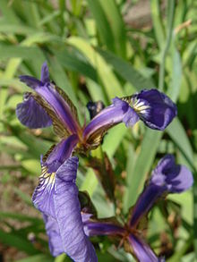

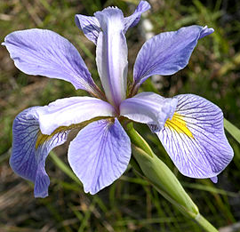
Structure of training and test data
Input | Output
Laura | F
Carlos | M
Jose | M
Maria | F
Belen | F
Iris setosa
Iris versicolor
Iris virginica

Slide 12
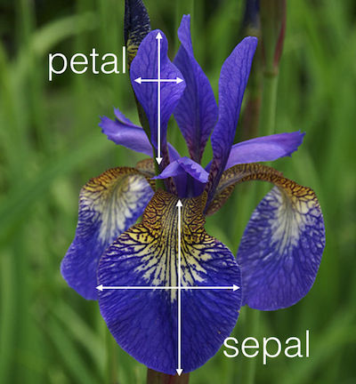
Input | nchars | lastchar | nvowels | Output
Laura | 5 | ‘a’ | 3 | F
Carlos | 6 | ‘s’ | 2 | M
Jose | 4 | ‘e’ | 2 | M
Maria | 5 | ‘a’ | 3 | F
Belen | 5 | ‘n’ | 2 | F
Features/Feature vector
Label/ Class
Sepal. Length | Sepal. Width | Petal. Length | Petal. Width | Output
5.1 | 3.5 | 1.4 | 0.2 | setosa
4.9 | 3.0 | 1.4 | 0.2 | setosa
7.0 | 3.2 | 4.7 | 1.4 | versicolor
6.3 | 3.3 | 6.0 | 2.5 | virginica
… | … | … | … | …

Slide 13
Supervised Learning
Features
Labels
Petal Length | Petal Width | Sepal Length | Sepal Width | Species
5.1 | 3.5 | 1.4 | 0.2 | Setosa
4.9 | 3.0 | 1.4 | 0.2 | Setosa
6.2 | 2.9 | 4.3 | 1.3 | Versicolor
6.3 | 3.3 | 6.0 | 2.5 | Virginica
5.1 | 2.5 | 3.0 | 1.1 | Versicolor
7.1 | 3.0 | 5.9 | 2.1 | Virginica
an instance
Training data
5.1 | 3.5 | 1.4 | 0.2 | ?
7.1 | 3.0 | 5.9 | 2.1 | ?
Predictions

Slide 14
Supervised Learning
Features
Labels
Petal Length | Petal Width | Sepal Length | Sepal Width | Species
5.1 | 3.5 | 1.4 | 0.2 | Setosa
4.9 | 3.0 | 1.4 | 0.2 | Setosa
6.2 | 2.9 | 4.3 | 1.3 | Versicolor
6.3 | 3.3 | 6.0 | 2.5 | Virginica
5.1 | 2.5 | 3.0 | 1.1 | Versicolor
7.1 | 3.0 | 5.9 | 2.1 | Virginica
Training data
Split for evaluation
Test data

Slide 15
Supervised Learning
Features
Labels
Petal Length | Petal Width | Sepal Length | Sepal Width | Species
5.1 | 3.5 | 1.4 | 0.2 | Setosa
4.9 | 3.0 | 1.4 | 0.2 | Setosa
6.2 | 2.9 | 4.3 | 1.3 | Versicolor
6.3 | 3.3 | 6.0 | 2.5 | Virginica
5.1 | 2.5 | 3.0 | 1.1 | Versicolor
7.1 | 3.0 | 5.9 | 2.1 | Virginica
Training data
train features
train labels
Split for evaluation
test features
test labels
Test data

Slide 16
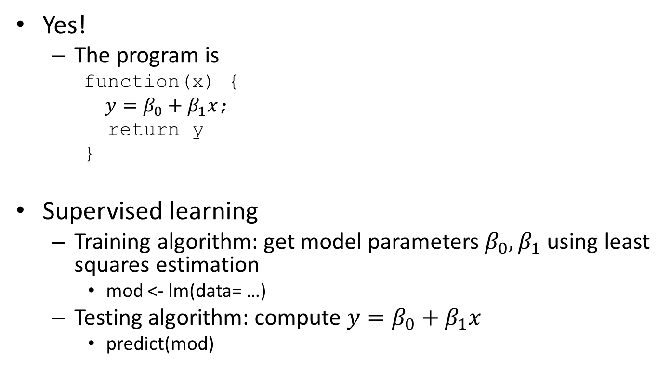
Is linear regression machine learning?
Yes!
The program is
function(x) {
$y=β_{0}+β_{1}x$;
return y
}
Supervised learning
Training algorithm: get model parameters $β_{0},β_{1}$ using least squares estimation
mod <- lm(data= …)
Testing algorithm: compute $y=β_{0}+β_{1}x$
predict(mod)

Slide 17
Model-based learning
Linear regression
Model is a linear equation
Decision trees
Model is a decision tree
Bayesian networks
Model uses probabilities
Neural networks
Model is a network of artificial neurons
…

Slide 18
Instance-based learning
What if we don’t know the model structure?
Linear, quadratic, …?
Instance-based learning
No explicit model, predict directly from data (instances)
Learning is just storing all the training data
When a new instance is given:
Get from stored instances a set of similar instances
Use the classes of the similar instances to classify the new instance

Slide 19
k-Nearest Neighbor (k-NN) algorithm
Simplest instance-based method
Other approaches
Support Vector Machines
Vector quantization

Slide 20
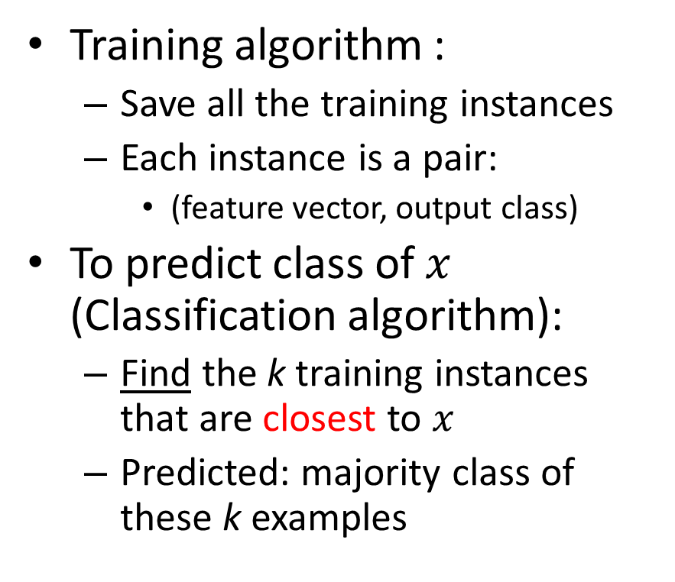
k-Nearest Neighbor classification
Training algorithm :
Save all the training instances
Each instance is a pair:
(feature vector, output class)
To predict class of $x$ (Classification algorithm):
Find the k training instances that are closest to $x$
Predicted: majority class of these k examples
Train instances
k=3
Majority class
x
prediction
Test instance

Slide 21
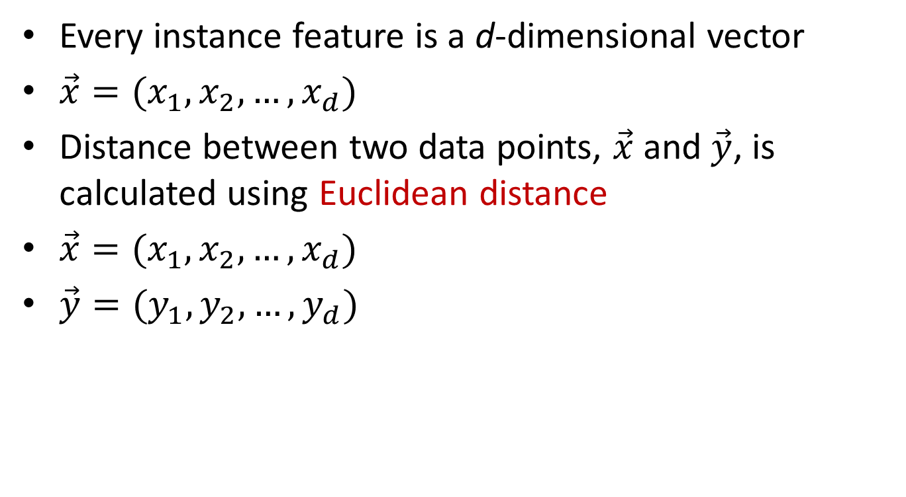
“Closest” in vector space
Every instance feature is a d-dimensional vector
$\vec{x}=(x_{1},x_{2},…,x_{d})$
Distance between two data points, $\vec{x}$and $\vec{y}$, is calculated using Euclidean distance
$\vec{x}=(x_{1},x_{2},…,x_{d})$
$\vec{y}=(y_{1},y_{2},…,y_{d})$

Slide 22
Classwork
Compute the Euclidean distance between vectors
(5, 0, -1)
(7, 3, 5)
Do it by hand
Check with R

Slide 23
Classwork
Consider this training data
Using 1-NN, what is the predicted output for name “Chris”?
Using 3-NN, what is the predicted output for name “Chris”?
 | nchars | Is_last_a | nvowels | Output
“Laura” | 5 | 1 | 3 | F
“Carlos” | 6 | 0 | 2 | M
“Jose” | 4 | 0 | 2 | M
“Maria” | 5 | 1 | 3 | F
“Belen” | 5 | 0 | 2 | F

Slide 24
k-NN in R
install.packages(“class”)
library(class)
knn(train = <data>, test=<data>, cl=<train labels>, k=3)
Note: cl prefers a vector. To make a vector out of a column inside a data.frame:
mydataframe$columnname
mydataframe[[1]] # get 1st column

Slide 25
How to determine the value for k?
Determined experimentally
Split data into two: train and test sets
Start with k=1 and use the test set to validate the error rate of the classifier
Repeat with k=k+1
Choose the value of k for which the error rate is minimum
Look for the “elbow” in the error vs. k curve
Note: if there are only 2 classes, choosing k to be odd (1,3,5,…) avoids ties

Slide 26

How to determine the value for k?
A “rule-of-thumb”
Choose $k=\sqrt{n}$ where n is number of instances
For iris, $n$ = ?
$k$ =

Slide 27
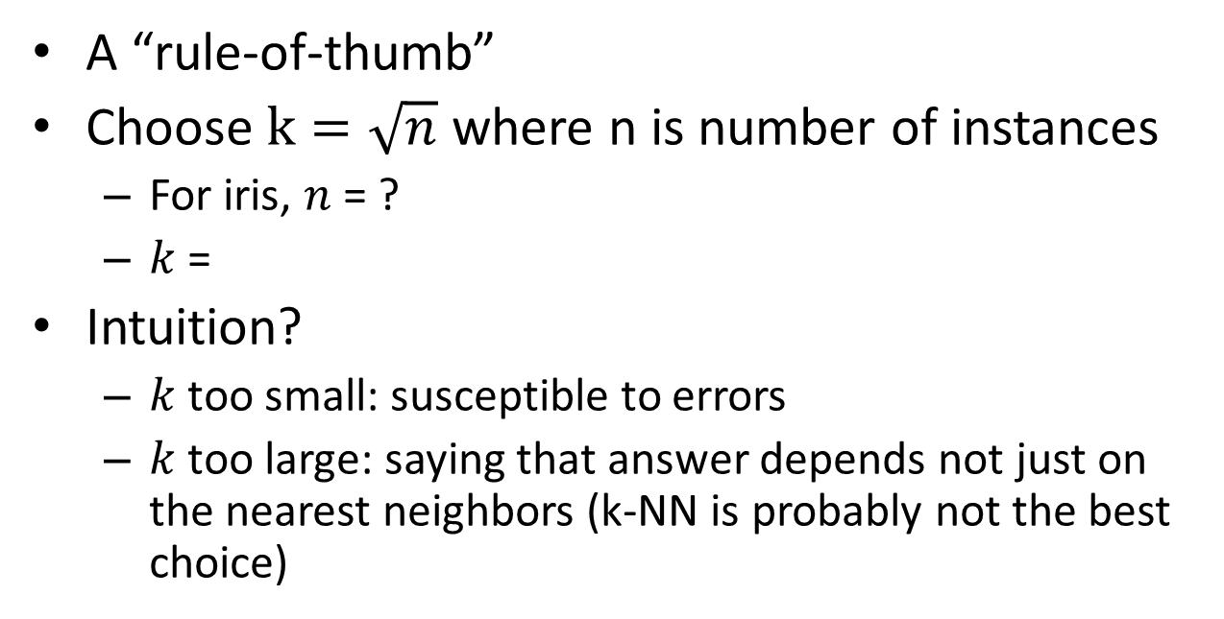
How to determine the value for k?
A “rule-of-thumb”
Choose $k=\sqrt{n}$ where n is number of instances
For iris, $n$ = ?
$k$ =
Intuition?
$k$ too small: susceptible to errors
$k$ too large: saying that answer depends not just on the nearest neighbors (k-NN is probably not the best choice)

Slide 28
Classwork
The pima-indians-diabetes-resampled.csv file on Canvas contains records indicating whether the subjects have diabetes or not, along with certain diagnostic measurements. The goal is to predict if a subject has diabetes, given some of the diagnostic measurements (only Preg and Pedigree).
Which is the “class” variable? Which is/are the “feature” variables?
Split the dataset into train and test datasets with the first 500 rows for training, and the remaining rows for test
Do NOT randomly sample the data
Train and test a 1-nearest neighbor (1-NN) classifier with this dataset
What is the error rate (number of misclassifications)?

Slide 29
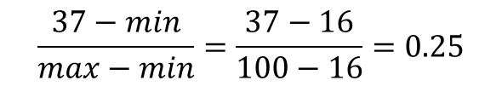
Normalization
Units matter!
Large valued features dominate the distance calculation
Normalization:
Convert each feature independently into comparable ranges (e.g., 0… 1)
Percentile:
Proportion of the Min to Max range
Example:
16 100
37
$$\frac{37−min}{max−min}=\frac{37−16}{100−16}=0.25$$
0 1
$1,000 $ 100,000
$55,000

Slide 30
Continuous-valued target functions
Calculate the mean value of the k nearest training examples
Instead of their most common value

Slide 31
Curse of Dimensionality
Imagine instances described by 20 features
BUT only 3 are relevant to target class
Curse of dimensionality:
nearest neighbor is misled when instance space is high-dimensional
Dominated by large number of irrelevant features
At very large number of dimensions
Euclidean distance itself becomes less useful
Distances between all pairs of points start taking on similar values
Can no longer use the intuition that closeness means correctness

Slide 32
Dimensionality reduction
Remove variables from the dataset that are not relevant to the class being predicted
How to identify such variables?
Can use linear regression
Fit a linear model between predicted class and each variable (one at a time)
Prioritize variables in order of their linear model fit
Will not always work
Two variables may not be correlated with the class on their own
But are important when taken together

Slide 33
When to use k-Nearest Neighbors
Instances map to points in a vector space
Lots of training data

Slide 34
Advantages of k-Nearest Neighbors
Training is very fast
Just store the instances
Learn complex target functions

Slide 35
Disadvantages of k-Nearest Neighbors
Slow at query time
Nearly all computation takes place at classification time rather than learning time
Presorting and indexing training samples into search trees reduces time
Starts failing with increasing dimensions

Slide 36
Consider this data set
X | Y
2 | EVEN
11 | ODD
23 | ODD
8 | EVEN
18 | EVEN
7 | ODD
3 | ?

Slide 37
What went wrong?
The distance metric
Used Euclidean distance
Should have used parity

Slide 38
Distance metrics
Distance metric:
Formula defining the distance between two points in the vector space
Most common: Euclidean distance
Square root of the sum of squared differences of each component
Select distance metric appropriate for the problem

Slide 39
Distance metrics
Manhattan distance
Jaccard similarity
Cosine similarity
Edit distance or Hamming distance
A custom distance metric

Slide 40
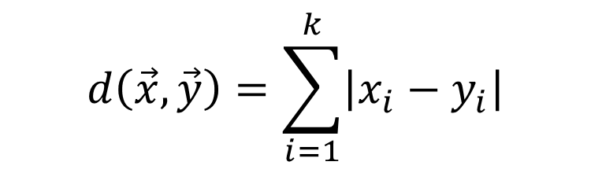
Manhattan distance
Euclidean distance:
L2 norm
Manhattan distance:
L1 norm
$$d\left(\vec{x},\vec{y}\right)=\sum_{i=1}^{k}{\left|x_{i}−y_{i}\right|}$$

Slide 41
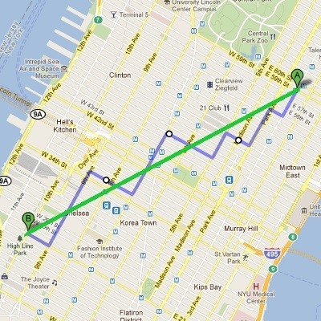
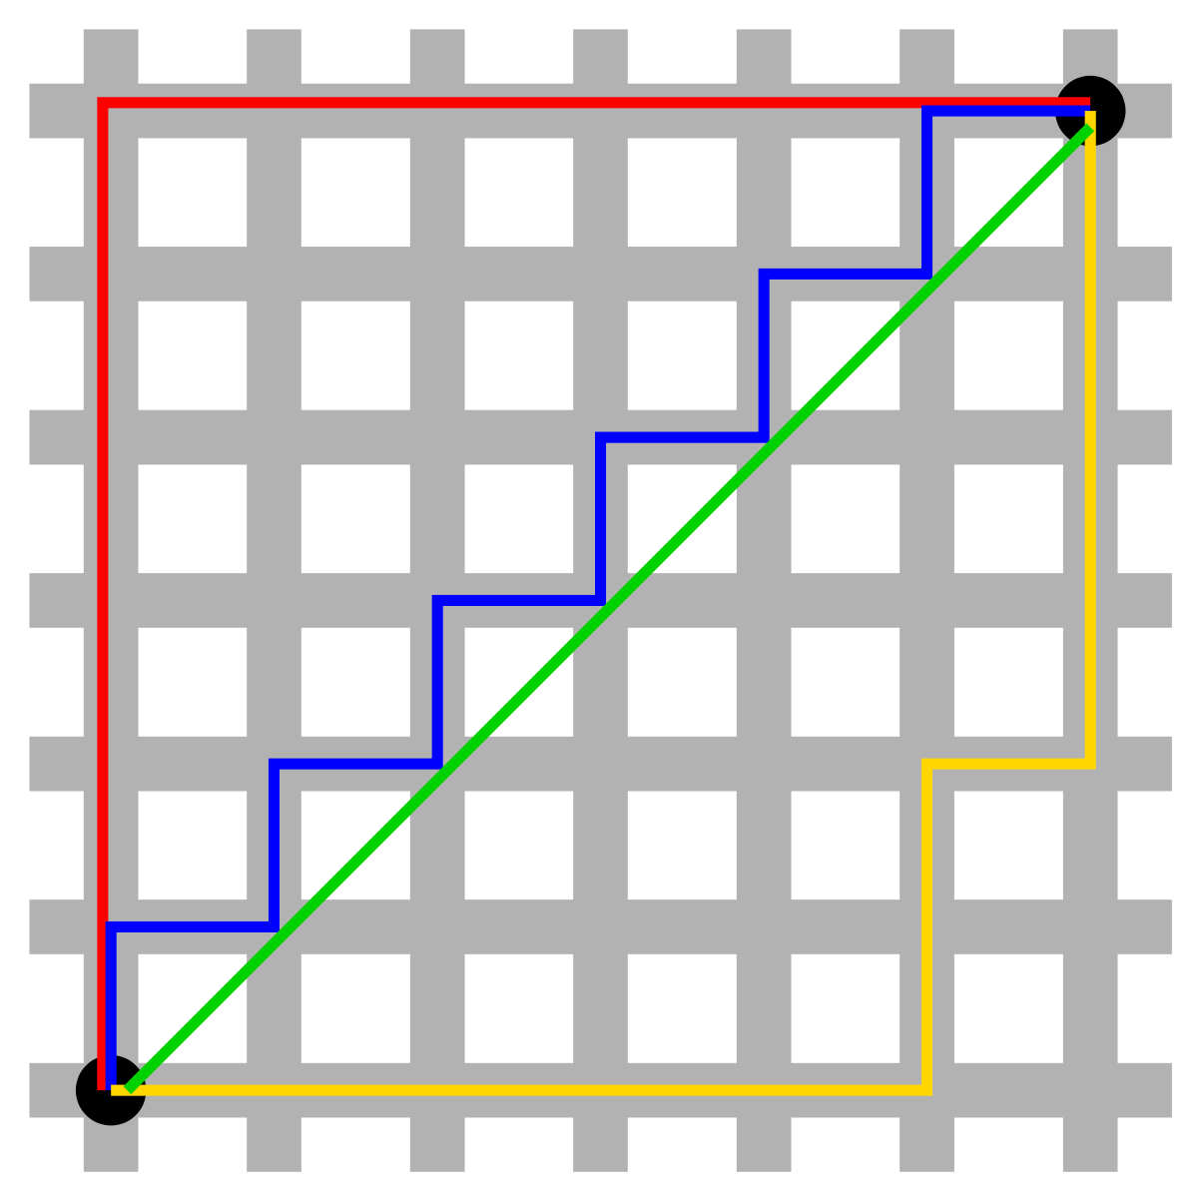
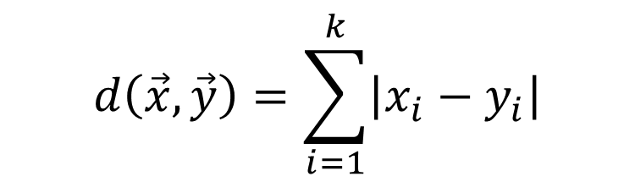
Manhattan distance
$$d\left(\vec{x},\vec{y}\right)=\sum_{i=1}^{k}{\left|x_{i}−y_{i}\right|}$$
Euclidean distance:
“As the crow flies”
Manhattan distance:
“Walking only on streets”

Slide 42
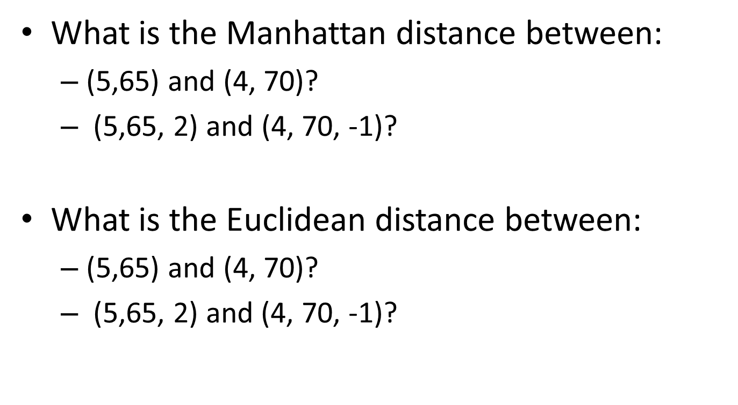
Manhattan distance
What is the Manhattan distance between:
(5,65) and (4, 70)?
(5,65, 2) and (4, 70, -1)?
What is the Euclidean distance between:
(5,65) and (4, 70)?
(5,65, 2) and (4, 70, -1)?

Slide 43
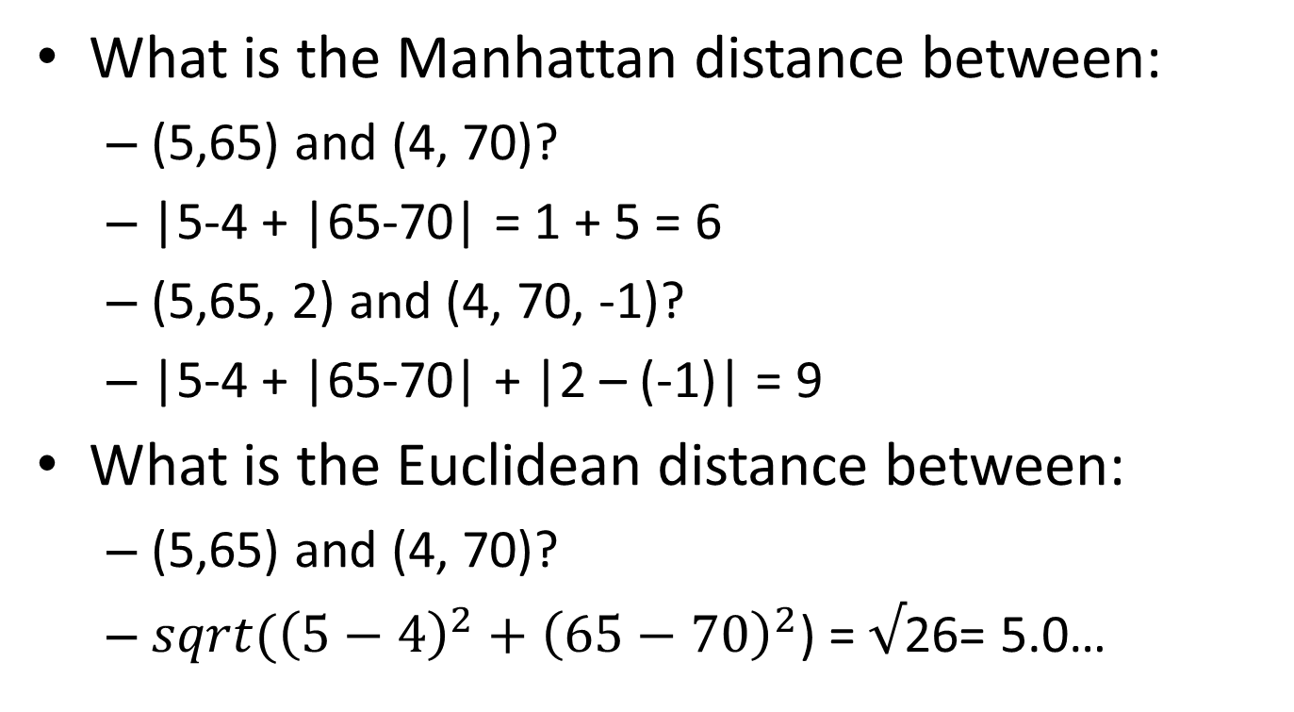
Manhattan distance
What is the Manhattan distance between:
(5,65) and (4, 70)?
|5-4 + |65-70| = 1 + 5 = 6
(5,65, 2) and (4, 70, -1)?
|5-4 + |65-70| + |2 – (-1)| = 9
What is the Euclidean distance between:
(5,65) and (4, 70)?
${sqrt(\left(5−4\right)}^{2}+{\left(65−70\right)}^{2}$) = $√$26= 5.0…

Slide 44
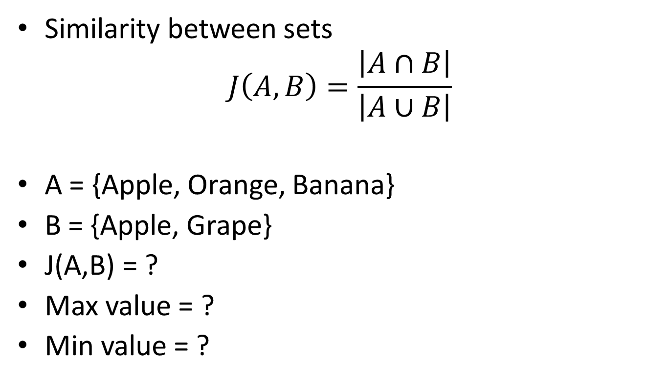
Jaccard similarity
Similarity between sets
$$J\left(A,B\right)=\frac{\left|A∩B\right|}{\left|A∪B\right|}$$
A = {Apple, Orange, Banana}
B = {Apple, Grape}
J(A,B) = ?
Max value = ?
Min value = ?

Slide 45
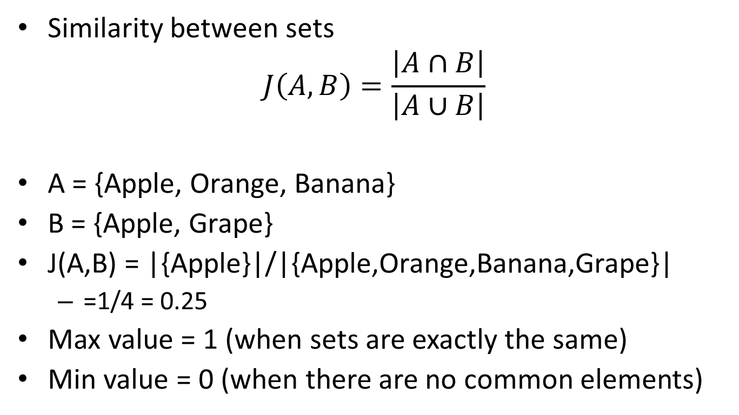
Jaccard similarity
Similarity between sets
$$J\left(A,B\right)=\frac{\left|A∩B\right|}{\left|A∪B\right|}$$
A = {Apple, Orange, Banana}
B = {Apple, Grape}
J(A,B) = |{Apple}|/|{Apple,Orange,Banana,Grape}|
=1/4 = 0.25
Max value = 1 (when sets are exactly the same)
Min value = 0 (when there are no common elements)

Slide 46
Use 1-NN algorithm to predict
A | {Apple, Banana, Soymilk, Yoghurt} | Vegetarian
B | {Apple, Peanuts, Yoghurt} | Vegetarian
C | {Tomatoes, Potatoes, Yoghurt} | Meat-eater
D | {Apples,Tomatoes, Potatoes} | Meat-eater
E | {Apples, Tomatoes} | ?
F | {Yoghurt} | ?

Slide 47
Use 1-NN algorithm to predict
A | {Apple, Banana, Soymilk, Yoghurt} | Vegetarian
B | {Apple, Peanuts, Yoghurt} | Vegetarian
C | {Tomatoes, Potatoes, Yoghurt} | Meat-eater
D | {Apples,Tomatoes, Potatoes} | Meat-eater
E | {Apples, Tomatoes} | ?=Meat-eater: class(D)
F | {Yoghurt} | ?=both B,C are nearest neighbors, pick randomly
Jaccard similarity(E,A) = 1/5 = 0.2
Jaccard similarity(F,A) = 1/4 = 0.25
Jaccard similarity(E,B) = 1/4 = 0.25
Jaccard similarity(F,B) = 1/3 = 0.33
Jaccard similarity(E,C) = 1/4 = 0.25
Jaccard similarity(F,C) = 1/3 = 0.33
Jaccard similarity(E,D) = 2/3 = 0.66
Jaccard similarity(F,D) = 0/4 = 0

Slide 48
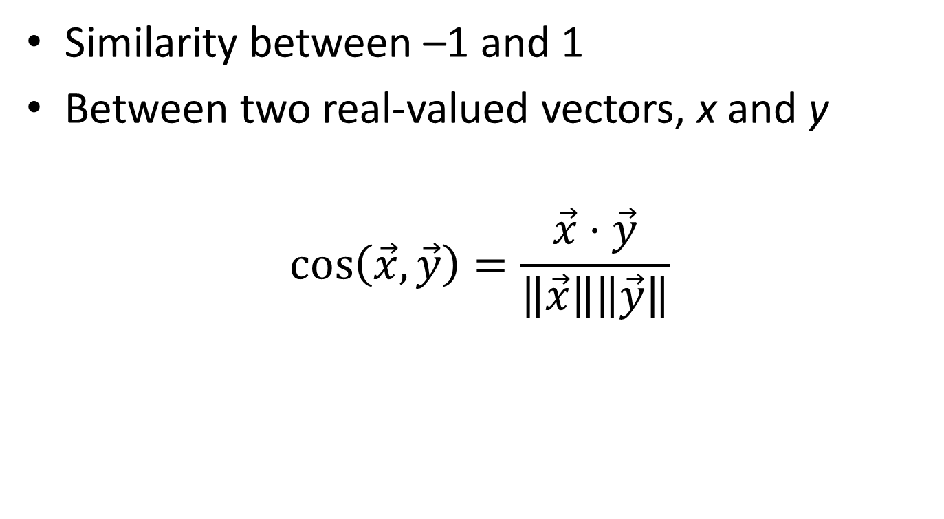
Cosine similarity
Similarity between –1 and 1
Between two real-valued vectors, x and y
$$\cos\left(\vec{x},\vec{y}\right)=\frac{\vec{x}⋅\vec{y}}{\left\|\vec{x}\right\|\left\|\vec{y}\right\|}$$

Slide 49
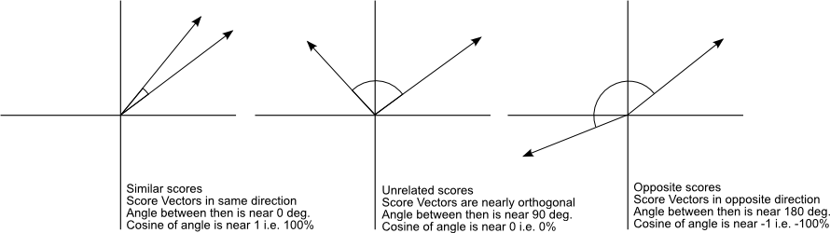
Cosine similarity

Slide 50
Hamming distance
Compare two strings
Difference character-by-character of two strings
Eg.: distance between “shoe” and “hose”
=?
Strings can be DNA sequences
AGTCAA and GATCAA

Slide 51
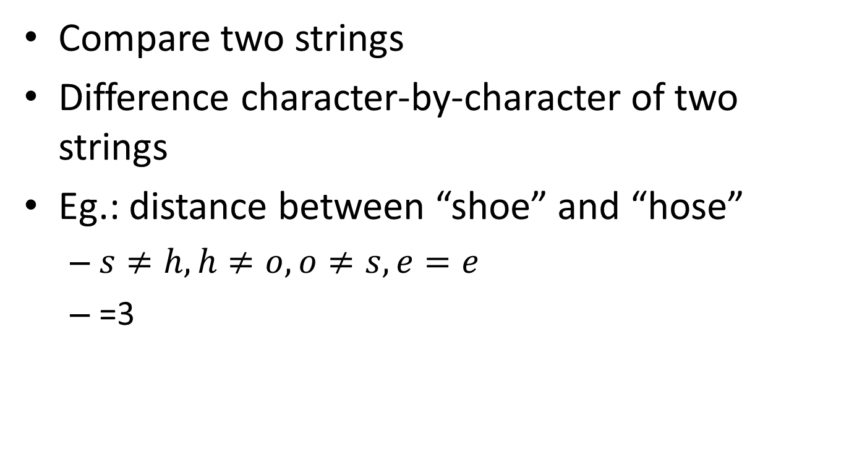
Hamming distance
Compare two strings
Difference character-by-character of two strings
Eg.: distance between “shoe” and “hose”
$s≠h,h≠o,o≠s,e=e$
=3

Slide 52
Custom distance metrics
If you have domain knowledge, then construct a distance metric specific to the domain
E.g., know that dimension 1 is more important than dimension 2

